Slide 1
Operating Systems Structure
Part 2

Slide 2
Operating System Design and Implementation (Cont.)
Important principle to separate
Policy: What will be done? Mechanism: How to do it?
Mechanisms determine how to do something, policies decide what will be done
The separation of policy from mechanism is a very important principle, it allows maximum flexibility if policy decisions are to be changed later (example – timer)
Specifying and designing an OS is highly creative task of software engineering

Slide 3
Implementation
Much variation
Early OSs were designed in assembly language (low level symbolic language converted by an assembler)
Then system programming languages like Algol, PL/1
Now C, C++
Actually usually a mix of languages
Lowest levels in assembly
Main body in C
Systems programs in C, C++, scripting languages like PERL, Python, shell scripts
More high-level language easier to port to other hardware
But slower
Emulation can allow an OS to run on non-native hardware

Slide 4
Operating System Structure
Simple structure – MS-DOS
More complex -- UNIX
Layered – an abstraction
Microkernel -Mach

Slide 5
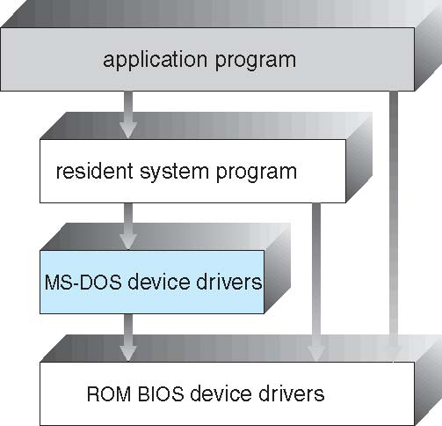
Simple Structure -- MS-DOS
MS-DOS – written to provide the most functionality in the least space
Not divided into modules
Although MS-DOS has some structure, its interfaces and levels of functionality are not well separated

Slide 6
Non Simple Structure -- UNIX
UNIX – limited by hardware functionality, the original UNIX operating system had limited structuring. The UNIX OS consists of two separable parts
Systems programs
The kernel
Consists of everything below the system-call interface and above the physical hardware
Provides the file system, CPU scheduling, memory management, and other operating-system functions; a large number of functions for one level

Slide 7
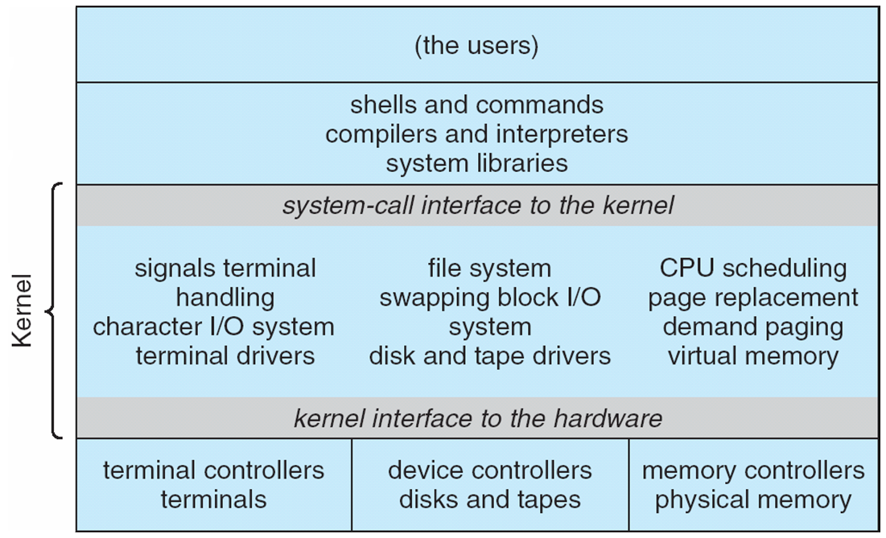
Traditional UNIX System Structure
Beyond simple but not fully layered

Slide 8
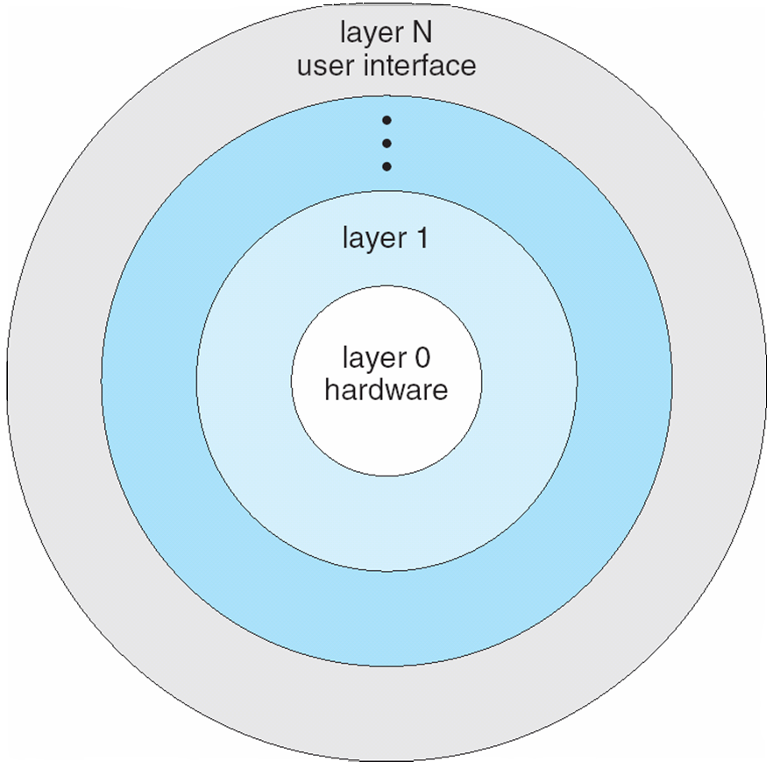
Layered Approach
The operating system is divided into a number of layers (levels), each built on top of lower layers.
The bottom layer (layer 0), is the hardware; the highest (layer N) is the user interface.
With modularity, layers are selected such that each uses functions (operations) and services of only lower-level layers

Slide 9
Microkernel System Structure
Moves as much from the kernel into user space
Mach example of microkernel
Mac OS X kernel (Darwin) partly based on Mach
Communication takes place between user modules using message passing
Benefits:
Easier to extend a microkernel
Easier to port the operating system to new architectures
More reliable (less code is running in kernel mode)
More secure
Detriments:
Performance overhead of user space to kernel space communication

Slide 10
Microkernel System Structure

Slide 11
Modules
Many modern operating systems implement loadable kernel modules
Uses object-oriented approach
Each core component is separate
Each talks to the others over known interfaces
Each is loadable as needed within the kernel
Overall, similar to layers but with more flexible
Linux, Solaris, etc

Slide 12
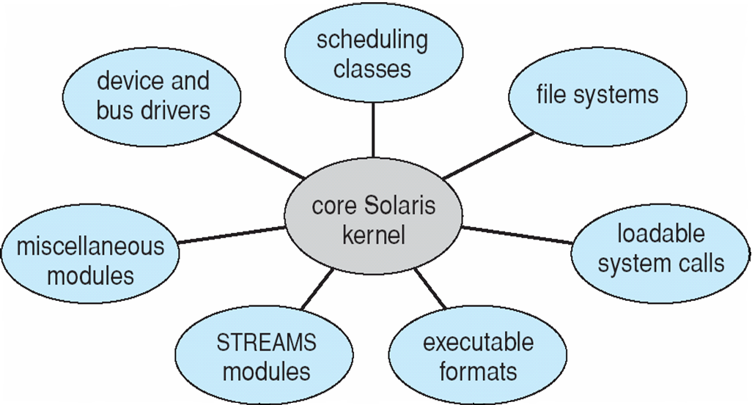
Solaris Modular Approach

Slide 13
Hybrid Systems
Most modern operating systems are actually not one pure model
Hybrid combines multiple approaches to address performance, security, usability needs
Linux and Solaris kernels in kernel address space, so monolithic, plus modular for dynamic loading of functionality
Windows mostly monolithic, plus microkernel for different subsystem personalities
Apple Mac OS X hybrid, layered, Aqua UI plus Cocoa programming environment
Below is kernel consisting of Mach microkernel and BSD Unix parts, plus I/O kit and dynamically loadable modules (called kernel extensions)

Slide 14
Mac OS X Structure

Slide 15
iOS
Apple mobile OS for iPhone, iPad
Structured on Mac OS X, added functionality
Does not run OS X applications natively
Also runs on different CPU architecture (ARM vs. Intel)
Cocoa Touch Objective-C API for developing apps
Media services layer for graphics, audio, video
Core services provides cloud computing, databases
Core operating system, based on Mac OS X kernel

Slide 16
Android
Developed by Open Handset Alliance (mostly Google)
Open Source
Similar stack to IOS
Based on Linux kernel but modified
Provides process, memory, device-driver management
Adds power management
Runtime environment includes core set of libraries and Dalvik virtual machine
Apps developed in Java plus Android API
Java class files compiled to Java bytecode then translated to executable than runs in Dalvik VM
Libraries include frameworks for web browser (webkit), database (SQLite), multimedia, smaller libc

Slide 17
Android Architecture

Slide 18
Operating-System Debugging
Debugging is finding and fixing errors, or bugs
OS generate log files containing error information
Failure of an application can generate core dump file capturing memory of the process
Operating system failure can generate crash dump file containing kernel memory
Beyond crashes, performance tuning can optimize system performance
Sometimes using trace listings of activities, recorded for analysis
Profiling is periodic sampling of instruction pointer to look for statistical trends
Kernighan’s Law: “Debugging is twice as hard as writing the code in the first place. Therefore, if you write the code as cleverly as possible, you are, by definition, not smart enough to debug it.”

Slide 19
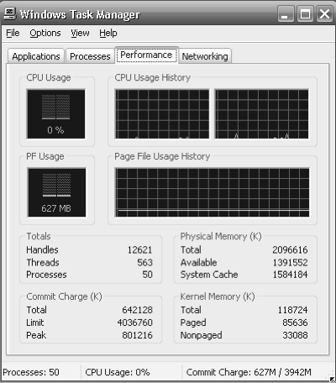
Performance Tuning
Improve performance by removing bottlenecks
OS must provide means of computing and displaying measures of system behavior
For example, “top” program or Windows Task Manager

Slide 20
Operating System Generation
Operating systems are designed to run on any of a class of machines; the system must be configured for each specific computer site
SYSGEN the process of configuring or generating an instance of an operating system for each individual computer site/architecture.

Slide 21
System Boot
When power initialized on system, execution starts at a fixed memory location
Firmware ROM used to hold initial boot code
Operating system must be made available to hardware so hardware can start it
Small piece of code – bootstrap loader, stored in ROM or EEPROM locates the kernel, loads it into memory, and starts it
Sometimes two-step process where boot block at fixed location loaded by ROM code, which loads bootstrap loader from disk
Common bootstrap loader, GRUB, allows selection of kernel from multiple disks, versions, kernel options
Kernel loads and system is then running

Slide 22
Revision questions
List at least three operating system services that are useful to users.
List at least three operating system functions that maintain efficient operation of the system.
What are the two different approaches for providing a user interface?
What is a system call?
What kernel data structure can be used for one technique of passing parameters to system calls?
List at least three of the major categories of system calls.
A program that has been loaded and executing is called a _____.

Slide 23
Revision questions cont;
What part of the operating system makes the decision with regards to which job will run?
List at least three of the categories of system programs.
True or False? The view most users see of the operating system is defined by application and system programs rather than system calls.
What are the two basic goal groups that must be considered when designing an operating system?
What is the difference between policy and mechanism?
List at least three different ways for structuring an operating system.
List at least two different hybrid operating systems.
What are the two devices that run the iOS operating system?

Slide 24
Revision questions cont;
What technique do microkernels use to communicate between services?
Provide an example of an operating system that uses the simple structure.
True or False? Performance tuning is a type of debugging.
Name two activities the operating system is responsible for in connection with disk management.
Of the following 5 forms of storage, rank them from fastest to slowest in terms of access time:
What does the term SYSGEN refer to?
What is the name of the small piece of code that locates the kernel and loads it into main memory?

